Slide 1
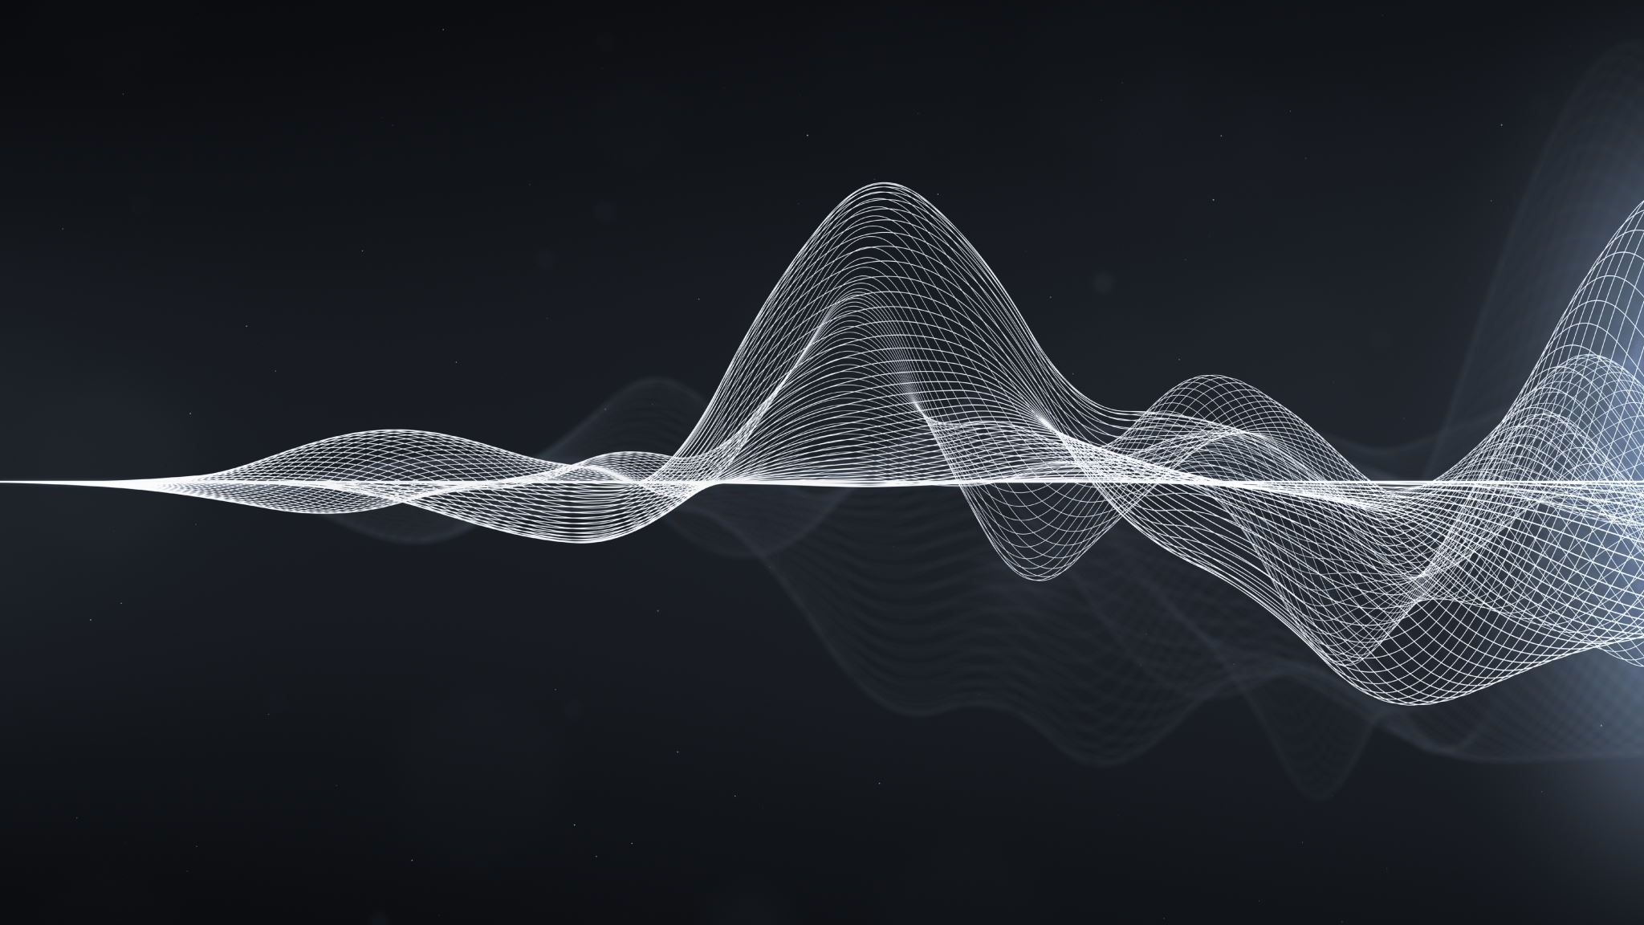
Detecting Mental Workload in Virtual Reality Using EEG Spectral Data: A Deep Learning Approach
Harshita Ved
Khoury College of Computer Sciences
Northeastern University
Boston, MA, USA
ved.h@northeastern.edu
Caglar Yildirim
Khoury College of Computer Sciences
Northeastern University
Boston, MA, USA
c.yildirim@northeastern.edu

Slide 2

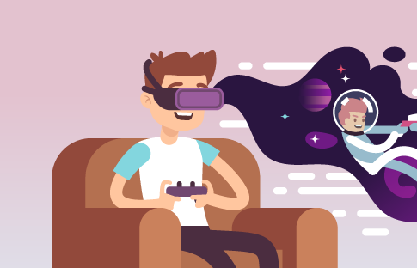
Introduction
With the rise of VR as an increasingly common medium for HCI, the importance of monitoring and detecting MWL is even more pronounced.
In the current study, we investigated the possibility of detecting MWL levels in VR on the basis of EEG brainwaves using deep learning models.

Slide 3
Pre-processing
Welch’s approach with a 256-point Fast Fourier Transform (FFT) was used to construct the frequency spectrum of the EEG for each 4-second run.
This method entailed breaking down the EEG signal into component frequency bands, each with its own set of functional features.
Delta (0–4 Hz), theta (4–8 Hz), alpha (8–14 Hz), beta (14–30 Hz), and gamma (30–60 Hz).
Brainwaves as Features:
Using MinMax Scaling individually for each participant’s recordings in contrast to standardization to end up with smaller standard deviations, which can dampen the effect of outliers.
Feature Normalization:

Slide 4
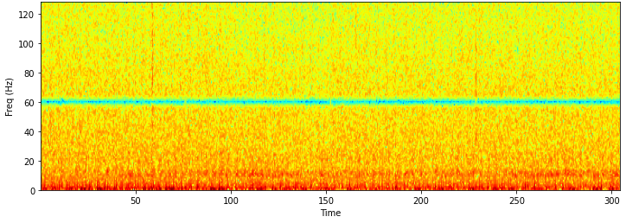
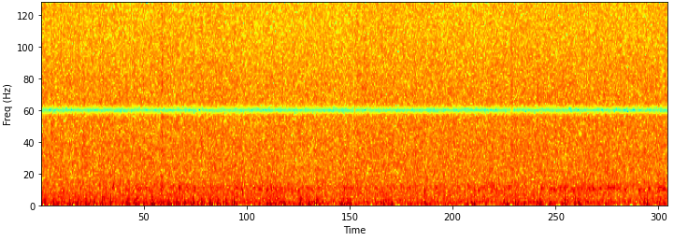
EEG Signals as Spectrograms:
We produced spectrograms to represent the EEG brainwaves as features in the CNN model.
Spectograms:

Slide 5
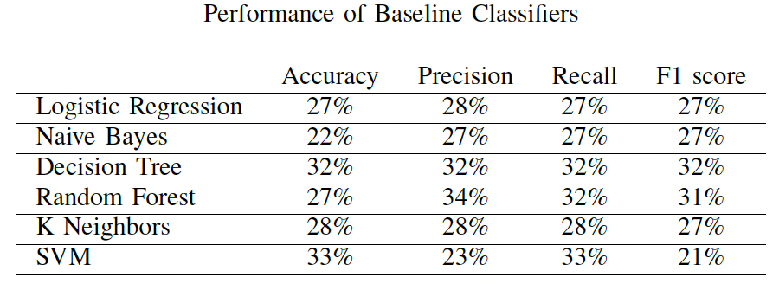
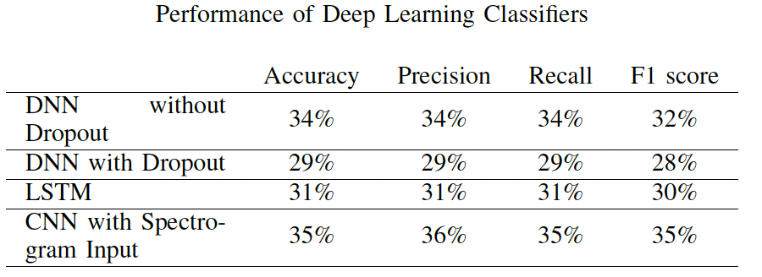
Machine Learning & Deep Learning Algorithms:

Slide 6

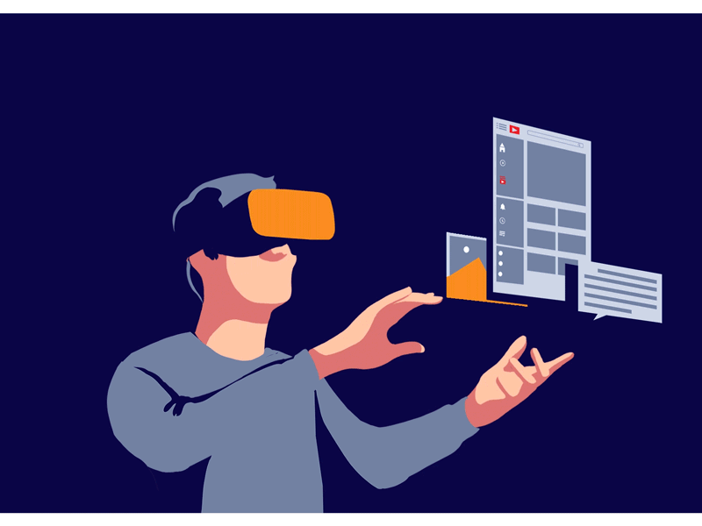
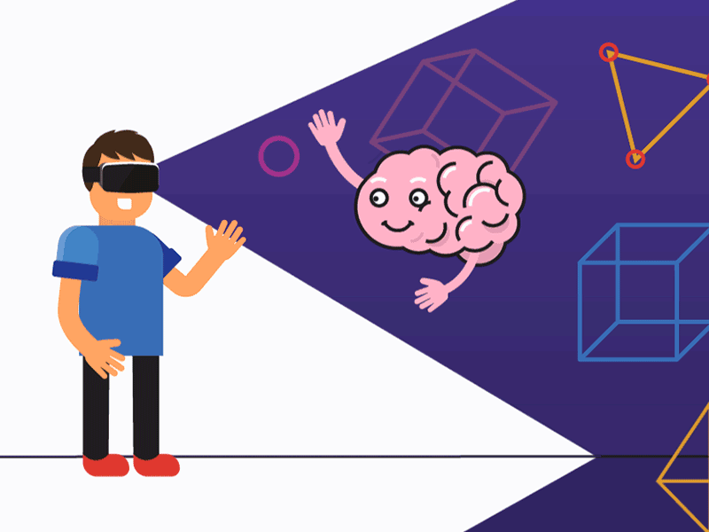
Results and Contribution
Pre-processing and representing EEG signal data as spectrograms for deep learning models.
Comparison of multiple traditional ML algorithms and modern DL techniques with respect to their performance.
Availability of the code used for future exploration and inspiration.

Slide 7
THANK YOU

